Slide 1
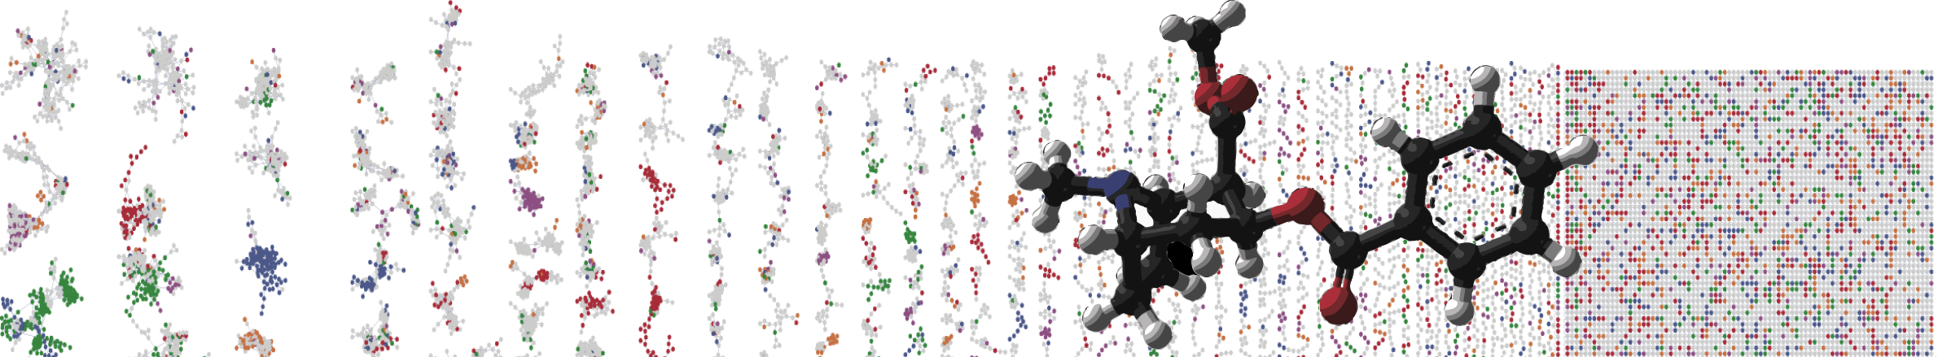


GNPS Molecular Networking Enhancer
Hands On
ENTER AUTHORS HERE
University of California - San Diego

Slide 2
MolNetEnhancer
Enhanced annotation!
Discover relevant
features!
Network
Annotation
Mining
Ernst et al., bioRxiv, 2019
https://github.com/madeleineernst/pyMolNetEnhancer
https://github.com/madeleineernst/RMolNetEnhancer
Ernst et al. (2019). https://www.biorxiv.org/content/10.1101/654459v1

Slide 3
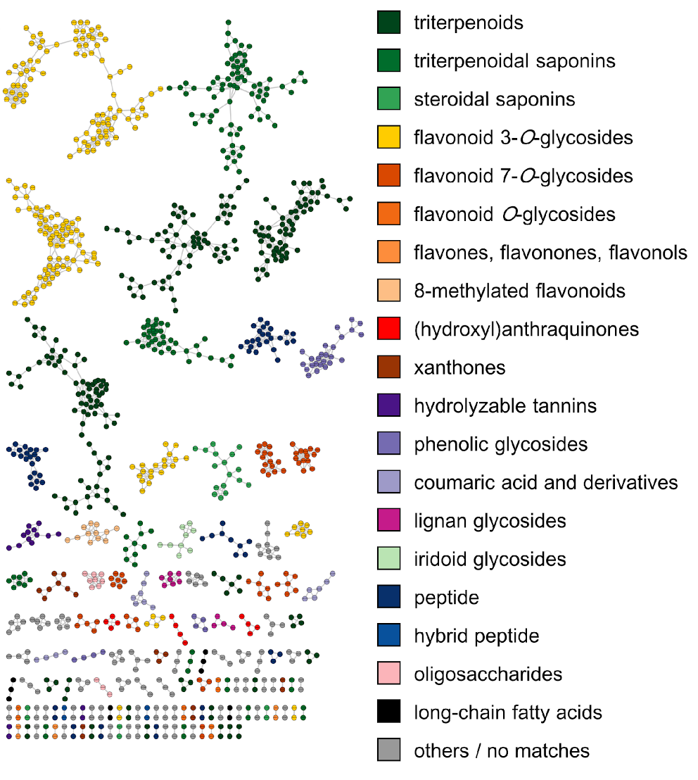
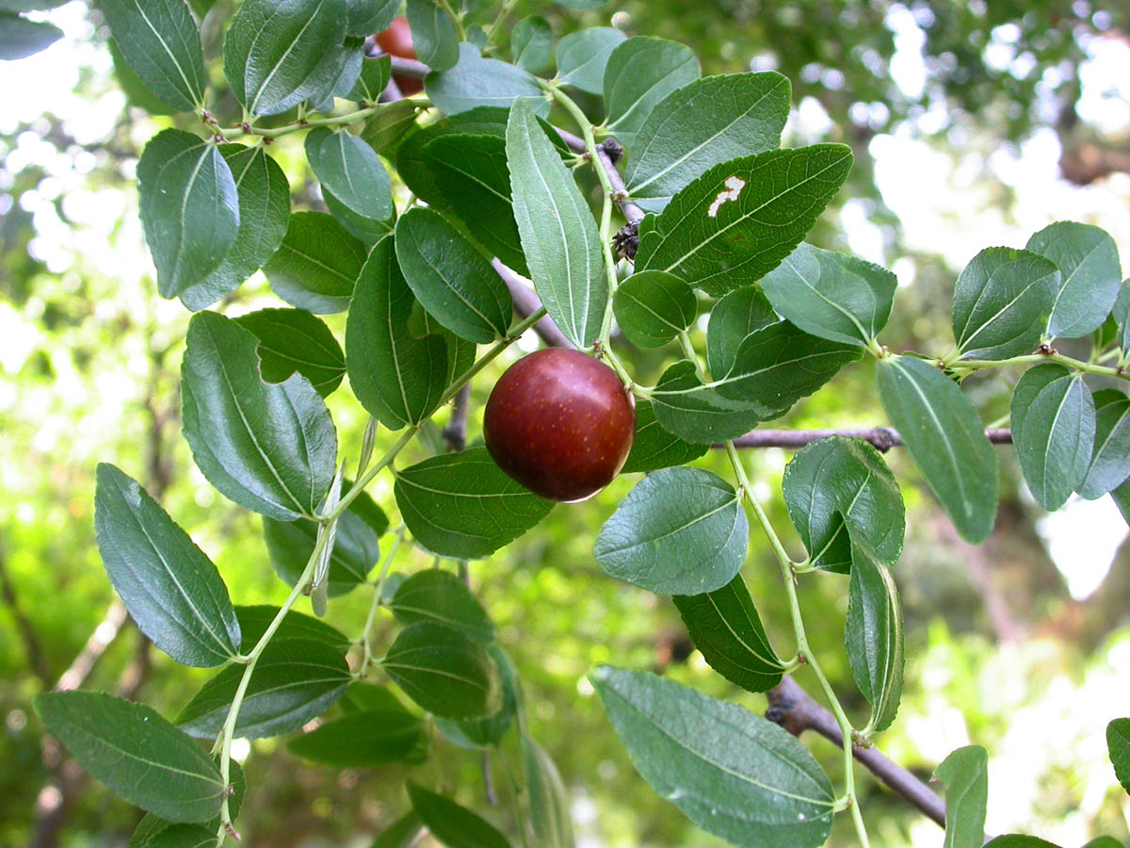

MolNetEnhancer: illuminating Rhamnaceae plant chemistry
Molecular Networking
plant related classifications:
different flavonoids
phenolic glycosides
triterpenoids
Wolfender et al.,
Anal. Chem., 2018
Dr Kyo Bin Kang, UCSD
Kang, Ernst, van der Hooft et al., The Plant Journal, 2019

Slide 4
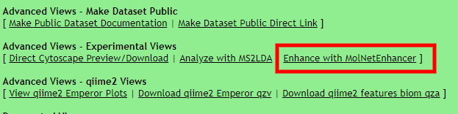
MolNetEnhancer Visualization
GNPS Job Link
https://gnps.ucsd.edu/ProteoSAFe/status.jsp?task=1ad7bc366aef45ce81d2dfcca0a9a5e7

Slide 5
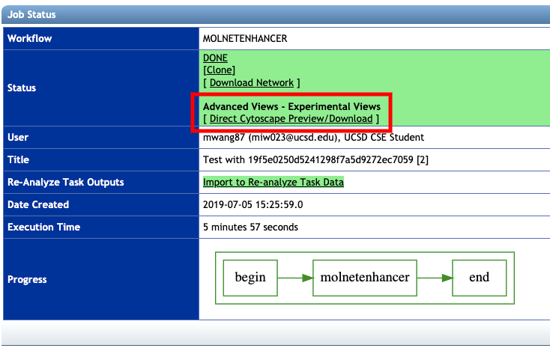
MolNetEnhancer Visualization
Interactive Link

Slide 6
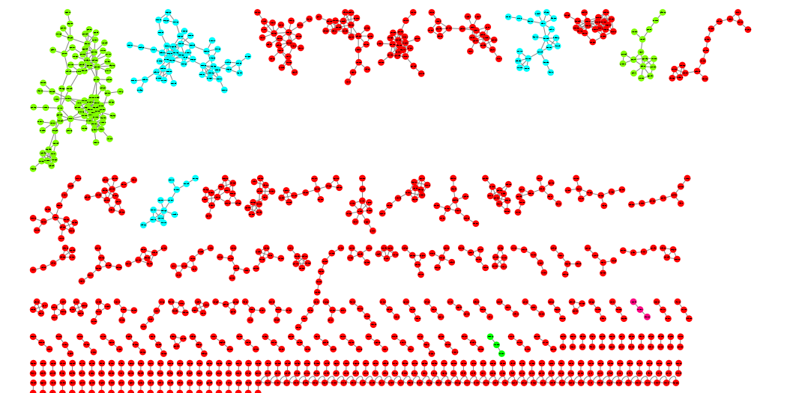
Network Visualization
Lipids and Lipid Like Molecules
Organic acids and derivatives
Interactive Link

